Slide 1

BRIGHT MOTORS
Sales Performance
& Market Analysis
Data Analytics Case Study • Executive Briefing
Prepared for: Head of Sales | BrightLearn Data Analytics

Slide 2
01 / CONTEXT
Business Overview
Bright Motors is a multi-state dealership operating in a competitive U.S. used-car market. A newly appointed Head of Sales is driving a strategic reset focused on growth, pricing discipline and inventory efficiency.
AT A GLANCE
$7.54B
Total Revenue
531,981
Vehicles Sold
PROBLEM
OBJECTIVES
$13,958
Uneven regional sales performance
Pricing inconsistency vs. market value (MMR)
Inventory not aligned to demand
Identify top revenue makes & models
Quantify pricing position vs MMR
Map regional opportunity
Optimise inventory mix
Avg Selling Price
13,718
Active Sellers
38
U.S. States
BRIGHT MOTORS • Sales Performance & Market Analysis
02

Slide 3
02 / DATA
Dataset Overview
The Bright Car Sales dataset captures daily transactional and pricing records for vehicles sold across the dealership network — enriched with market value (MMR) benchmarks for pricing efficiency analysis.
VEHICLE
COMMERCIAL
ENGINEERED
Make & Model
Year
Body Type
Transmission
Odometer (mileage)
Selling Price
MMR (Market Value)
Seller
State
Pricing Position
Market Gap
Pricing Bucket
Price Segment
Mileage Segment
Vehicle Age Group
Cleaning & transformation: removed duplicates, normalised text-based prices to numeric, derived market_gap = sellingprice − MMR, and bucketed vehicles by price, mileage and age tiers.
BRIGHT MOTORS • Sales Performance & Market Analysis
03

Slide 4
03 / APPROACH
Methodology
01
02
03
04
05
Ingest
Clean
Engineer
Visualise
Recommend
Raw Bright Car Sales CSV loaded into Databricks / SQL warehouse.
Normalise prices, deduplicate VINs, handle missing values & casing.
Build market_gap, pricing_position, age & mileage segments.
Looker Studio executive dashboard with cross-filtered KPIs.
Translate insights into actions for the Head of Sales.
Stack: Databricks • SQL • Looker Studio • PowerPoint
BRIGHT MOTORS • Sales Performance & Market Analysis
04

Slide 5
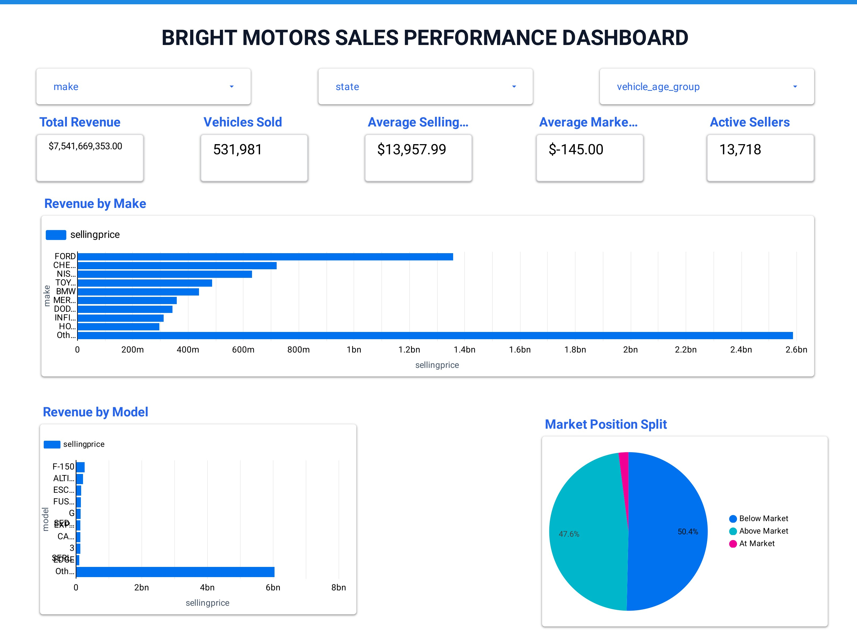
04 / DASHBOARD
Executive Dashboard Overview
BUILT IN LOOKER STUDIO
Single-pane visibility across revenue, pricing position, regional sales and customer preference — fully interactive with cross-filters.
$7.54B
Total Revenue
531,981
Vehicles Sold
$13,958
Avg Selling Price
−$145
Avg Market Gap
BRIGHT MOTORS • Sales Performance & Market Analysis
05

Slide 6
05 / REVENUE
Revenue & Top-Performing Makes
KEY INSIGHTS
Ford leads with ~$1.35B revenue — 18% of total sales.
Top 3 makes (Ford, Chevy, Nissan) drive ~36% of revenue.
F-150 is the #1 model at ~$150M — pickup demand is structural.
Premium makes (BMW, Mercedes) deliver high revenue per unit.
BRIGHT MOTORS • Sales Performance & Market Analysis
06

Slide 7
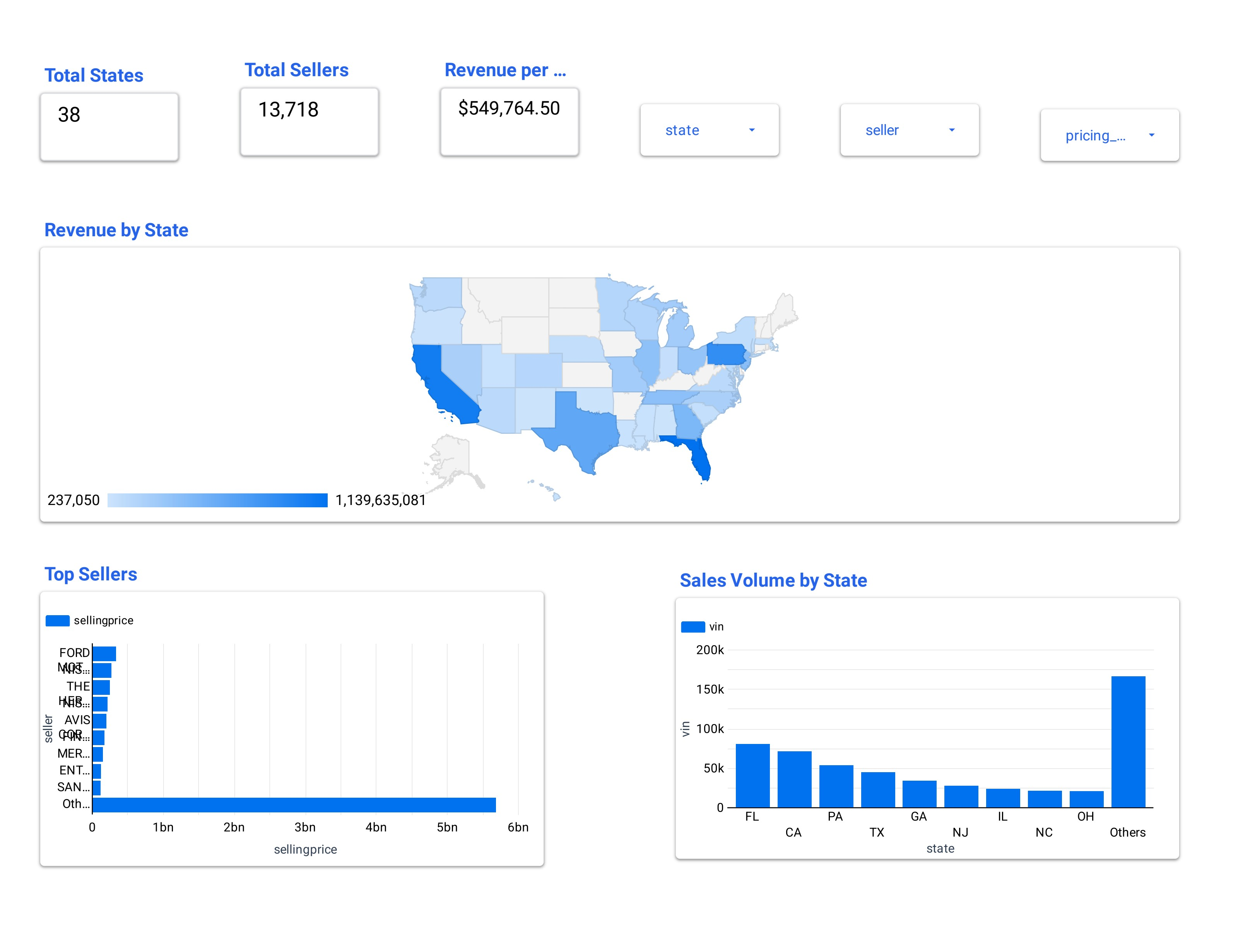
06 / REGIONS
Regional Performance
TOP STATES BY VOLUME
FL
80K units
CA
70K units
PA
55K units
TX
45K units
GA
35K units
INSIGHT
Florida & California alone account for ~28% of total volume — high-density markets to defend; mid-tier states (NC, OH, NJ) offer the clearest expansion runway.
BRIGHT MOTORS • Sales Performance & Market Analysis
07

Slide 8
07 / PRICING
Pricing Efficiency Analysis
50.4%
Below Market
Sold under MMR — leaves margin on the table.
47.6%
Above Market
Premium pricing — drives revenue but slows turn.
2.0%
At Market
Aligned to MMR — the sweet spot we want to grow.
Market gap (avg −$145) signals a slight discount bias — disciplined repricing of below-market inventory is the fastest margin lever.
BRIGHT MOTORS • Sales Performance & Market Analysis
08

Slide 9
08 / DEPRECIATION
Price vs Mileage
INSIGHTS
Strong inverse relationship — price falls sharply past 80K miles.
Sweet spot for inventory: 30K–80K miles, where price holds firmest.
High-mileage units (>120K) cluster under $5K and tie up floor space.
BRIGHT MOTORS • Sales Performance & Market Analysis
09

Slide 10
09 / AGE TREND
Vehicle Age vs Selling Price
DEPRECIATION CURVE
Newer vehicles (2018+) command ~5–7× the price of pre-2010 stock.
Steepest value drop occurs in the first 3 years of vehicle age.
Bias procurement toward 2–5 year-old vehicles to maximise margin.
BRIGHT MOTORS • Sales Performance & Market Analysis
10

Slide 11
10 / DEMAND
Top 5 Body Types by Customer Preference
SEDAN
Volume backbone — broad appeal, fast turn.
43%
SUV
Premium segment with strong margin headroom.
26%
CREW CAB
Niche but loyal buyers; bundle with finance.
4.5%
MINIVAN
Family-driven demand; keep lean stock.
3%
Sedans + SUVs = ~69% of demand. Tilt inventory and showroom space toward these two body types.
BRIGHT MOTORS • Sales Performance & Market Analysis
11

Slide 12

11 / ACTION
Key Recommendations
01
Double down on hero makes
02
Reprice below-market stock
Prioritise Ford, Chevrolet & Nissan in procurement — they drive 36% of revenue.
Tighten the 50% of inventory sold under MMR to recover average market gap.
03
Expand in high-velocity states
04
Optimise the inventory sweet spot
Reinforce FL & CA presence; pilot mid-tier states (NC, OH, NJ) for growth.
Target 2–5 year-old vehicles with 30K–80K miles to maximise margin per unit.
05
Lean into Sedans & SUVs
06
Industrialise pricing discipline
Allocate ~70% of inventory budget to the body types driving real demand.
Embed MMR-based pricing rules into the sales floor workflow.
Bright Motors • Strategic briefing for the Head of Sales
12

